Slide 1
Language ıdentıfıcatıon
Kaan mersın 21527214
Ahmet tarık kaya 21527156

Slide 2
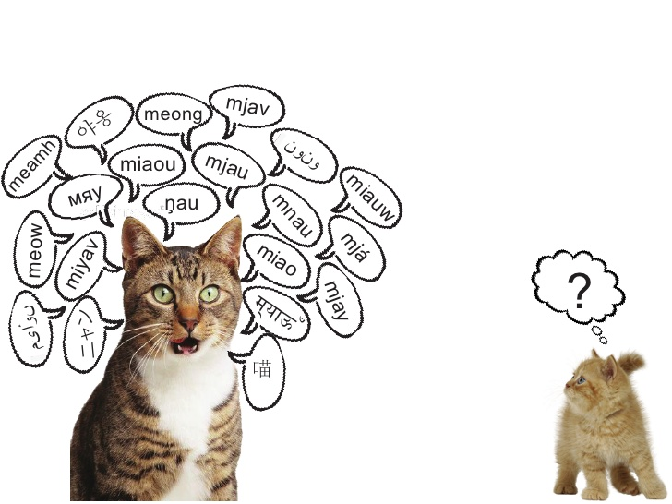
THE PROBLEM
Language Identification
European Languages
Translation

Slide 3
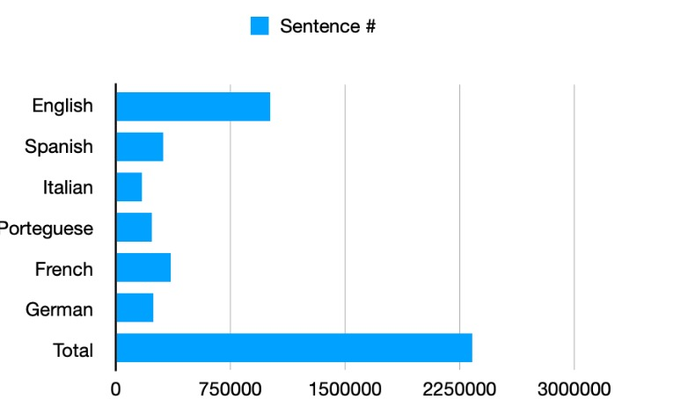
RELATED WORK & OUR Dataset
SVM
Recurrent Neural Networks
Old Newspapers Dataset
6 Languages

Slide 4
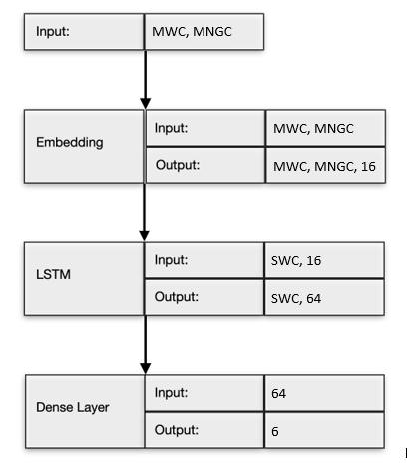
MODEL
Vectorizer
Embedding
Long Short Term Memory
Dense Layer

Slide 5
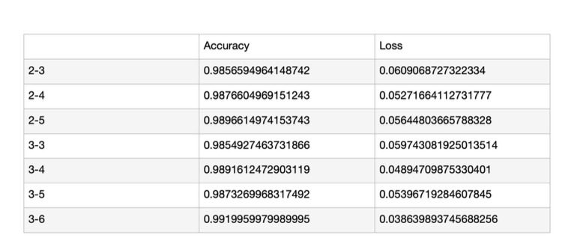
TUNING THE MODEL

Slide 6
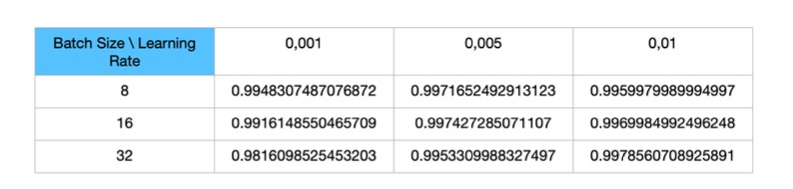
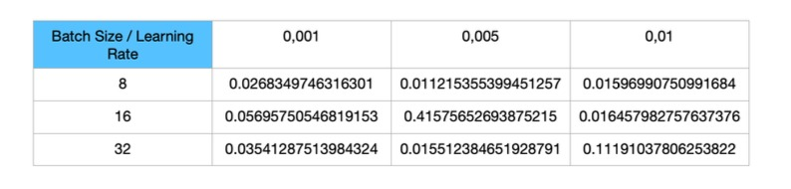
TUNING THE MODEL
Batch Size => 32
Learning Rate => 0.01
N-Gram => 3-6

Slide 7
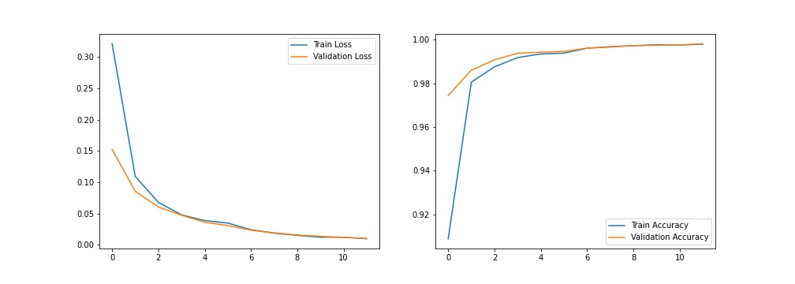
FINAL RESULTS

Slide 8
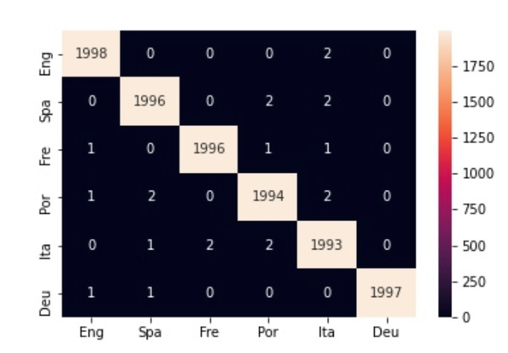
FINAL RESULTS
12 EPOCHS
FINAL ACCURACY => 99.82%
PROPER NAMES

Slide 9
Thank you for lıstenıng

